Slide 1
Welcome to 8th Grade Parent Night!

Slide 2
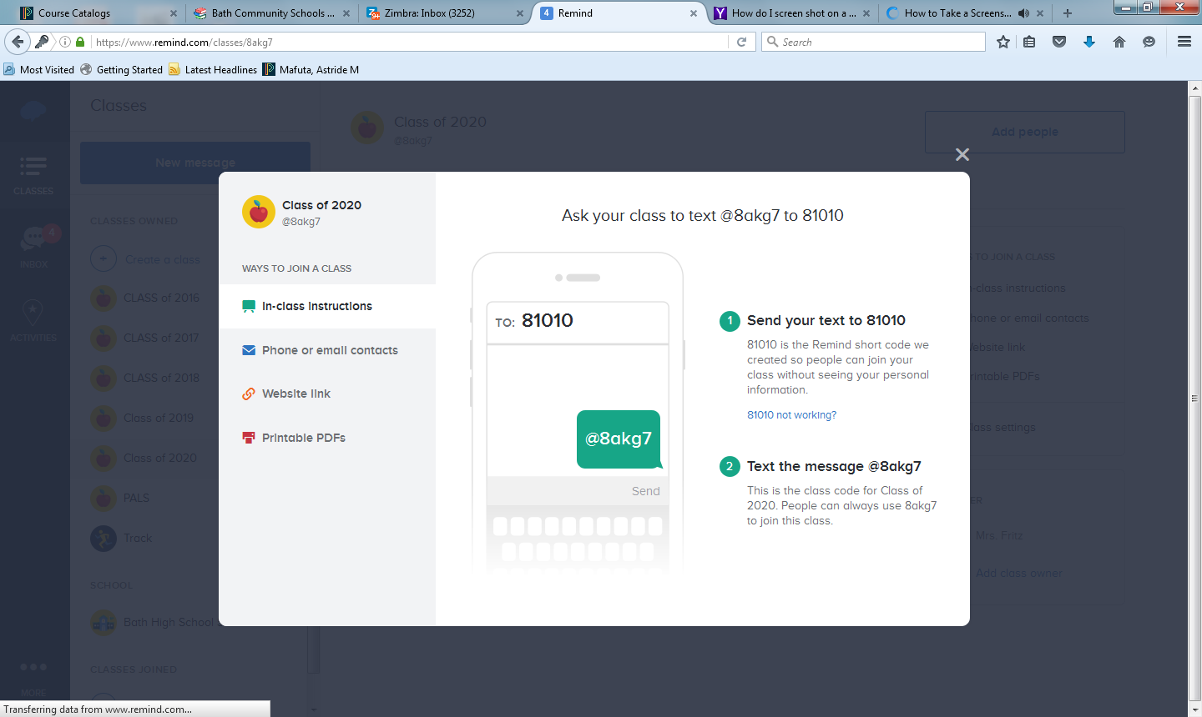

Slide 3
Welcome to 8th Grade Parent Night!

Slide 4
Counseling Office
Academics
Career
Emotional
Social
Visit the bathschools.net website for important updates and information!
efritz@bathschools.net or 517-641-6724

Slide 5
Bath High School Graduation Requirements
Subject Area
Required Courses
English
Social Studies
Science
Mathematics
English I, II, III, IV
US History, World History, Civics or AP Civics, Economics, any .5 of social studies elective
Intro to Physics, Biology, any 1.0 science elective
Algebra I, Geometry, Algebra II, any 1.0 senior level math (4 years total)

Slide 6
Requirements continued
Subject Area
Required Courses
Physical Education
Visual Performing Arts
Foreign Language
Technology
Health (.5) & Physical Education (.5)
1.0 Credit
Spanish 2.0 Credit
Any 1.0 Credit
26 Credits are Required for Graduation

Slide 7
Required Junior and Senior Seminars
Junior Seminar
Standardized Testing Preparation
Career Exploration
Kaplan Seminars
SAT practice test
Senior Seminar
Large group instruction
Prepare students for entrance into college and the workplace
Required to graduate

Slide 8
Recommended College Preparatory Curriculum
Subject Area
Recommendation
English
Mathematics
Biological and Physical Science
Historical and Social Sciences
Foreign Language
4 years
4 years
4 years preferred
4 years preferred
3-4 years strongly recommended

Slide 9
Freshman Year Schedule
English I
U.S. History
Intro to Physics
Algebra I or Geometry (depends on current math placement and grade earned in class)
Spanish I or Spanish II (based on placement test and grades)
Health .5
P.E. or Aerobics and Wellness .5
Elective .5
*Concert Band Students will take Health, and/or P.E credit the following year.

Slide 10
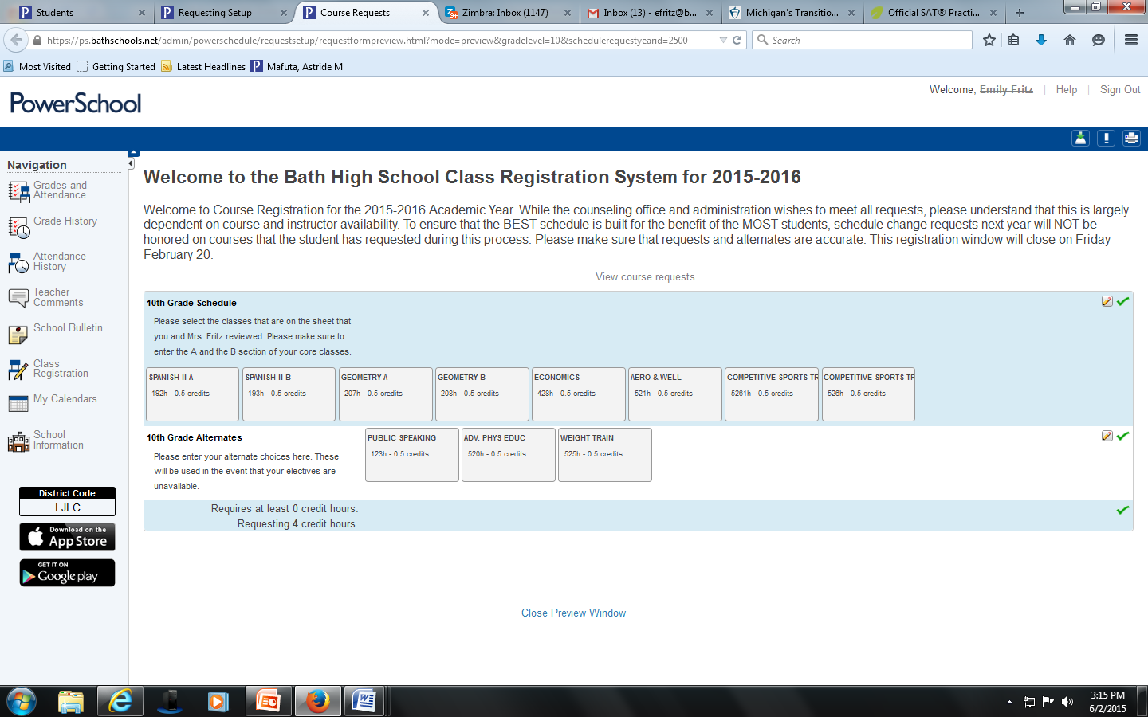
Power School Scheduling and Graduation Progress

Slide 11
Extended Learning Opportunities at Bath High School

Slide 12
Vocational Education
Classes offered through CCRESA and EISD
See online curriculum guide for current offerings
Offered junior and/or senior years
Attendance and GPA requirements
Most offer Lansing Community College Credit

Slide 13
Dual Enrollment
Attend college classes and earn college credit
Bath Community Schools pays tuition
Must have exhausted curriculum opportunities offered by the school in subject area
College courses cannot be hobbies, craft or recreation courses, or in the subject areas of PE, theology or religious education

Slide 14
Advanced Placement Courses
AP English IV, AP Civics, and AP Calculus, AP Biology, AP U.S. History, AP Psychology
Students take exams in May
Colleges offer credit for qualifying scores on the AP exam.
Test currently costs parents $92.00

Slide 15
Articulated Credits
Students have an opportunity to earn Lansing Community College Credits by taking classes offered at Bath High School during junior or senior year (earned with B or better)
Accounting A & B
Web Design
Computer Programming
Additional opportunity for A++ and/or Microsoft certification

Slide 16
College Board Suite of Assessments
9th Grade: PSAT 9
10th Grade PSAT
11th Grade: SAT and MSTEP

Slide 17
Educational Development Plan
Developed individually by students and specific to each student’s educational and career goals
Can be updated at any time using Career Cruising (www.careercruising.com)
Started in 7th grade and updated yearly by student to account for current and future needs

Slide 18
Supports Offered at BHS

Slide 19
Staff
Powerschool
Staff Class Pages
Math Lab
Staff Email
Student/Staff Meetings
Homework Room (Monday through Thursday after school until 3:30)

Slide 20
Counseling Office
Learning Styles
Study Skills
Goal Setting
Plans of Improvement
Social/Emotional Counseling
Academic Success Groups
Freshman Mentor Program
Referrals to other agencies

